Slide 1




Sentiment Analysis of Amazon Customer Reviews
Shreyas Surendra
Yaswanth Santhanam Raghavan
Ramya Kondapi
Anupama Sinha
Spring 2020

Slide 2


Problem Statement
Develop a model that would determine the sentiment polarity of a customer’s review on a product

Slide 3
Problem Statement (contd.)
Problem Formulation
Task : Classification
Input:
A document d
A fixed set of classes C = {c1,c2,..,cn}
Output: A predicted class c ∈ C
d = amazon customer review
C = {positive, negative}

Slide 4
Problem Statement (contd.)
Motivation
Referred prior to purchasing a product
Crucial to make a judgement on the product
An added advantage to sellers
Can improve the product based on the reviews
Happy customers = Positivity about the brand
Marketing strategy

Slide 5
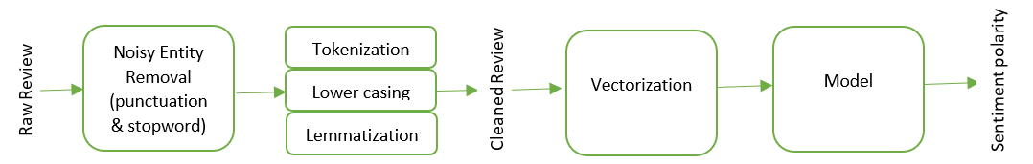
Methodology
Pipeline
The first two stages of the pipeline are implemented using two methods
Method A – SpaCy
Method B – NLTK

Slide 6
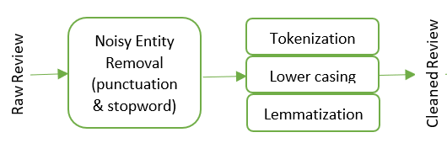
Methodology (contd.)
Preprocessing with Method A
Spacy: 2 attributes: “review_body”, “star_rating”,
Preprocessing: lowercasing, lemmatization, tokenization, removal of punctuations & stop words
Classes: SentiNet word database used to calculate intensities
Intensities: Values from -1 (extremely negative) to 1 (extremely positive), 0 indicates: Neutral
For 0: star_rating used: star_rating>=3→ positive. Negative otherwise.
Vectorization: countvectorizer, TF-IDF Vectorizer, both same results
Vocabulary size : 8810 words
Input Sentence: Harry Potter is a fabulous book.
Output words after Spacy preprocessing: Harry, potter, fabulous (3 words)
Review_body | Sentinet Score | Class
Harry, potter, fabulous | 0.793 | Positive

Slide 7
Methodology (contd.)
Models
Train (80%), Test (20%). Stratified data sampling.
Naïve Bayes, Support Vector Machine, Random Forest
Additionally: Neural Network

Slide 8
Methodology (contd.)
Models developed using Method A’s corpus
Naïve Bayes: Calculates prior and likelihood. Maximum probability value chosen.
SVM: Finds the finest hyperplane that separates the data. Confusion matrix shows predictions.
Random forest: Combination of different decision trees. Number of levels in each DT=100
ANN : Fully connected input layer, multiple hidden layers and Output layer. Epochs=[10,20]. Hidden layers=[2,3,4]. Neurons=[10,100]. Highest accuracy for 2 Hidden layers, 20 Epochs, 100 Neurons.

Slide 9
Methodology (contd.)
Motivation for Method B
spaCy omitted sentiment bearing words in a few scenarios Ex: “It is a good book”, “Sherlock Holmes is a good book”
Negation handling capabilities

Slide 10
Methodology (contd.)
Preprocessing with Method B
2 attributes: “review_body”, “star_rating”
Updated stopwords list to make sure negation words are not omitted
Too many words, removed words that appeared in product_title from review_body
Set threshold to 20 words
Vocabulary size : 3700 words
Classes: star_rating>=3: Positive; star_rating<3: Negative
Input Sentence: Harry Potter is a fabulous book.
Output words after NLTK preprocessing: Harry, potter, fabulous (3 words)
Review_body | Star_rating | Class
Harry, potter, fabulous | 4 | Positive

Slide 11
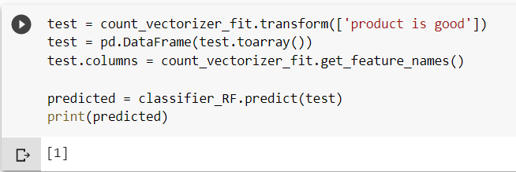
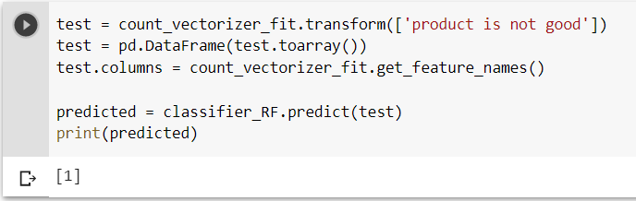
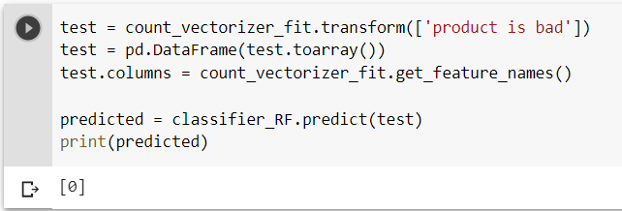
Methodology (contd.)
Models developed using Method B’s corpus
Naïve Bayes, SVM, Random forest
Achieved decent accuracy ~85%
Poor negation handling

Slide 12
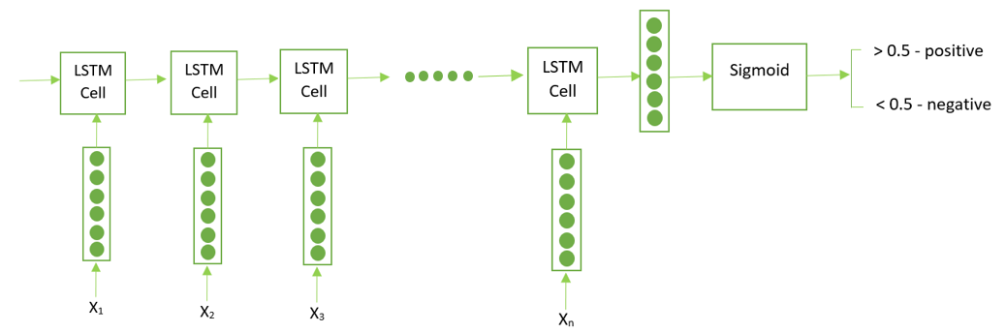
Methodology (contd.)
LSTM using Method B’s corpus
Advantage: Capability of learn dependency between words in a sequence

Slide 13
Methodology (contd.)
LSTM in TensorFlow and Keras
Embedding : 100-dimension GloVe embeddings
Vocabulary size : 3700
Embedding layer dimension: 3700 x 100
Layer of LSTM cell with 250 units
Output layer : A single neuron sigmoid classifier
Loss function: Cross entropy
Adam optimizer: RMSprop + Stochastic Gradient Descent with momentum.
Epochs: 15
Output: A scalar value from 0 to 1.
value >= 0.5 -> Positive; value < 0.5 -> Negative

Slide 14
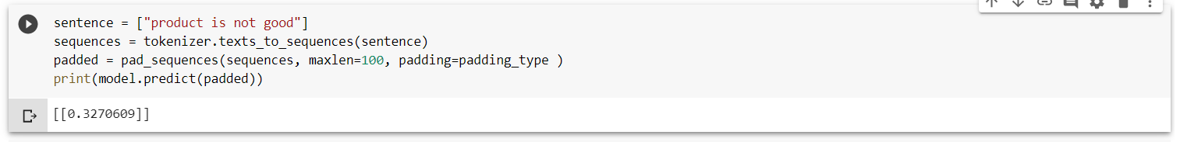
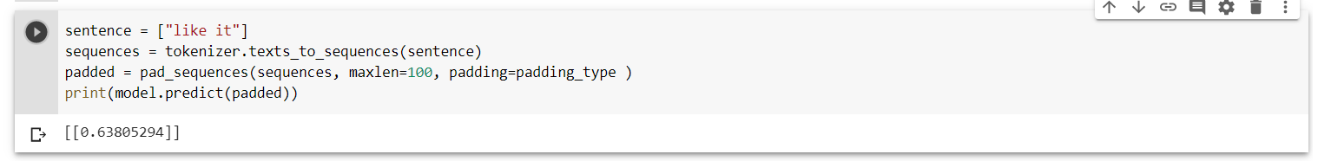
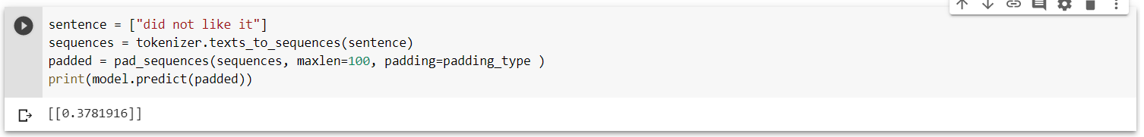
Methodology (contd.)
LSTM negation handling capability

Slide 15
Dataset and Evaluation Metrics
Amazon Customer Reviews Dataset from AWS.
Total: 14 attributes: 'marketplace', 'customer_id', 'review_id', 'product_id', 'product_parent', 'helpful_votes', 'total_votes', 'vine’, ‘product_title’, ‘star_rating’, ‘review_headline’, ‘review_body’
Worked with 4 attributes: ‘product_title’, ‘star_rating’, ‘review_headline’, ‘review_body’
Samples=104975
Vocabulary with Method A=8810
Vocabulary with Method B= 3700
Evaluation metrics: F1 score and Accuracy
Same values for both

Slide 16
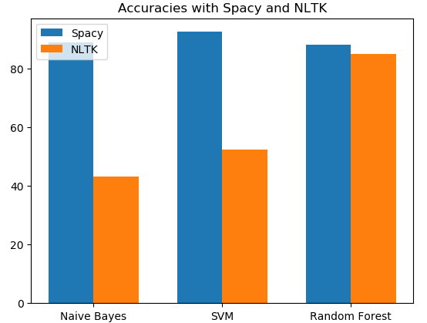
Evaluation Results
 | Naïve Bayes | SVM | Random Forest
Method A | 89.07 | 92.65 | 88.27
Method B | 43.35 | 52.48 | 85.01

Slide 17
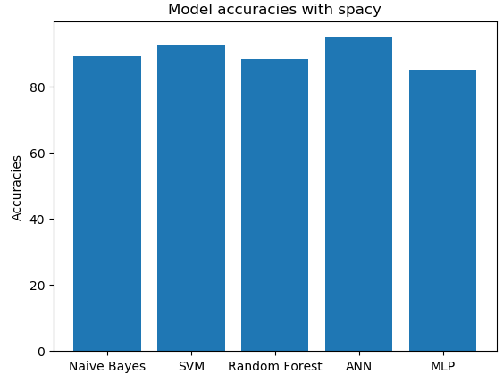
Evaluation Results (contd.)
Models using Method A’s vocabulary
Naïve Bayes | SVM | Random Forest | ANN | MLP
89.07 | 92.65 | 88.27 | 95.01 | 85.22

Slide 18
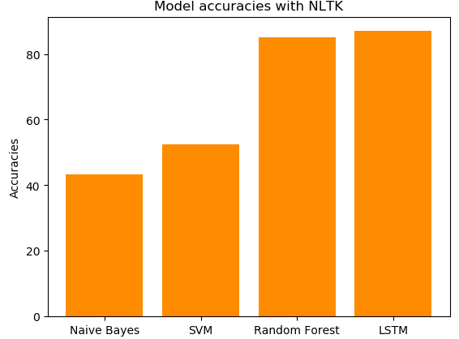
Evaluation Results (contd.)
Models using Method B’s vocabulary
Naïve Bayes | SVM | Random Forest | LSTM
43.35 | 52.48 | 85.01 | 86.98

Slide 19
Discussion
Spacy is better for reduced vocabulary size
NLTK is better for including sentiment bearing words
LSTM is better for prediction of sentences with negation words (with less accuracy)
Best accuracy is with ANN using spacy (95.01%)

Slide 20
Conclusion
Overall best combination: LSTM using NLTK
Used to predict a custom sentence, so any given length of text can be predicted as positive or negative based on the score
LSTM using spacy
Understand why Spacy is omitting sentiment bearing words
ANN, MLP using NLTK
Multiproduct-brands classification, compare between brands
Multi-seller classification, compare between sellers

Slide 21
Work Distribution
Model A |  | Model B |  | Documentation
Preprocessing | Model Implementation | Preprocessing | Model Implementation
Ramya: 40% Yaswanth: 40% | Yaswanth: 30% Ramya: 30% | Anupama: 50% Shreyas: 30% | Shreyas: 50% Anupama: 20% | Shreyas: 20% Yaswanth: 30% Ramya: 30% Anupama: 30%

